Slide 1

Multiple Linear Regression
Dustin Carrión

Slide 2
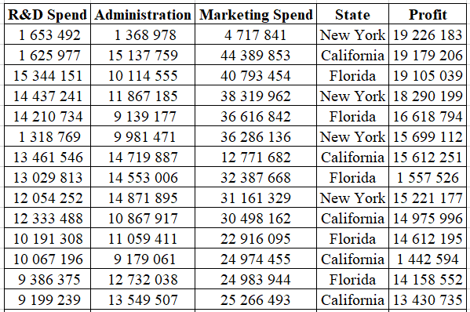
Dataset
50 Observations.
Business investments per year.
There is any relation?

Slide 3
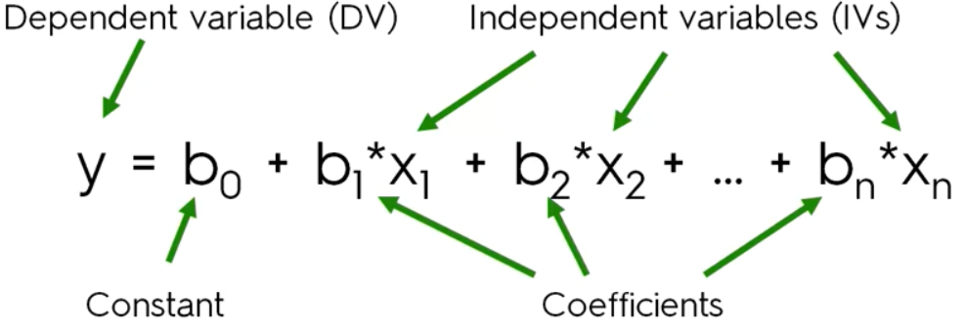
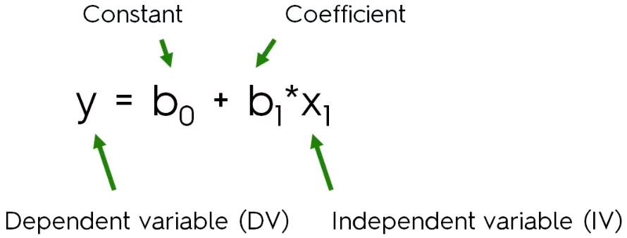
Formula

Slide 4
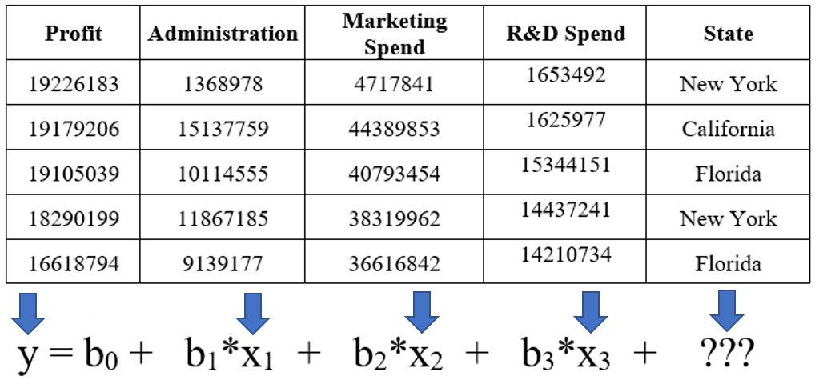
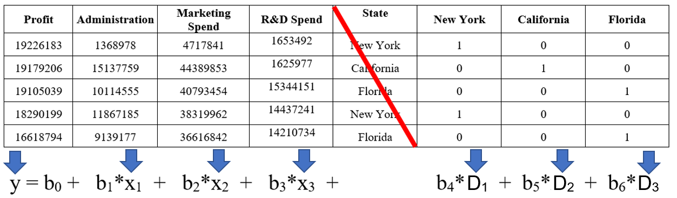
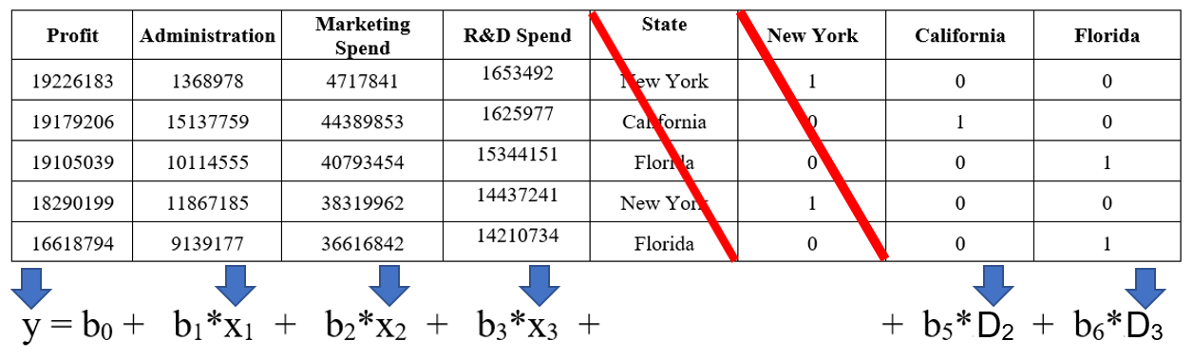

Dummy Variables

Slide 5
Model creation techniques
Score comparison
All-in
Backward elimination
Forward selection
Bidirectional elimination

Slide 6
Score comparison
Select a criterion to measure how good the model is (e.g. Accuracy, false positive rate, etc.).
Build all possible regression models with the available variables.
Select the best one depending on the criteria being used.

Slide 7
All-in
Include all information (variables) in the model. It's used when:
Prior knowledge of the importance of the variables.
It is a requirement.
Preparation of the model for Backward elimination.

Slide 8
Backward elimination
Select the confidence level (CL).
Fit the model with all possible variables.
See the P-values ​​of all variables and look for the largest. If P>CL go to the next step, otherwise stop the process.
Remove the variable with the highest P-value.
Adjust the model without taking into account the deleted variable.

Slide 9
Forward selection
Select the confidence level (CL).
Create all possible simple linear regression models and select the one with the lowest P-value.
Maintain that variable and create all possible models with an extra variable.
Consider the variable with the lowest P-value. If P<CL, repeat the previous step, otherwise stop the process and keep the previous model.

Slide 10
Bidirectional elimination
Select the level of confidence for adding a variable (CLA) and for keeping a variable (CLK).
Add new variables following the Forward selection process (P<CLA).
Execute all steps of Backward elimination using CLK.
No other variable can enter and none of the currently used variables can be deleted.

Slide 11
References
All this course is based on the Udemy course “Machine Learning A-Z™: Hands-On Python & R In Data Science” created by Kirill Eremenko, Hadelin de Ponteves, SuperDataScience Team, SuperDataScience Support.
(https://www.udemy.com/course/machinelearning/)

Slide 12

General Information
Place:
B-101
Meetings:
Tuesday 20:00 – 21:00
Facebook Group: CLUB DE DESARROLLO DE VIDEOJUEGOS E INTELIGENCIA ARTIFICIAL YACHAY TECH
GitHub: https://github.com/yachay-tech-ai

